Slide 1

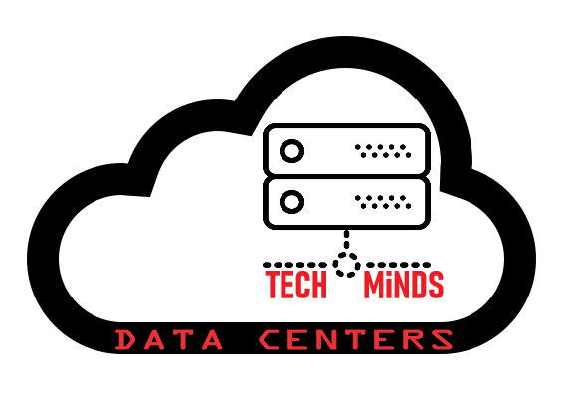
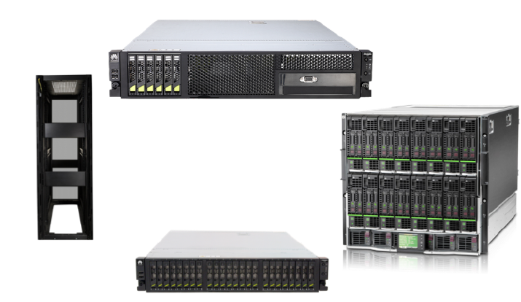
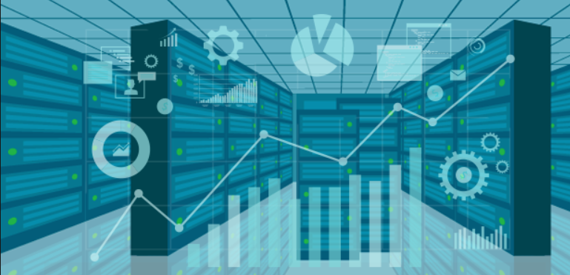
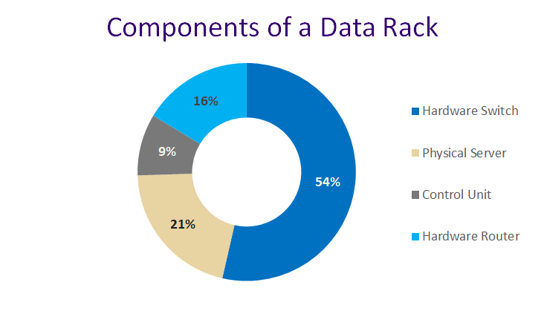

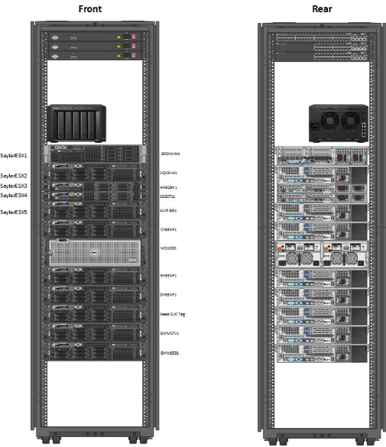
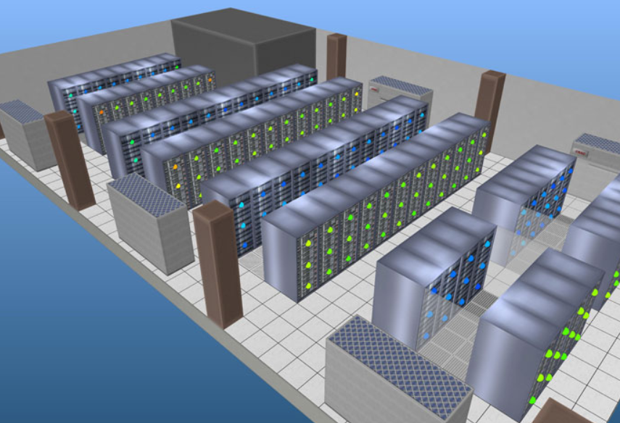
DATA CENTER AUTOMATION
By Team-
Serge EL ARAMOUNY, Venkatesh JEYARAJ, Vijaya Srikar PORALLA, Mohammed Zaid SYED, and Thaiveena PARTHASARTHY.
PROJECT DESCRIPTION
A data center is a facility used to keep computers, telecommunications and storage systems. It includes redundant or backup power supplies, data communication connections, environmental controls and security devices. It maintains thousands of machines carrying out the business and its customers.
The automation drawing module of a data center uses the CMDB information in a graphical manner, which makes it even simpler and flexible for the organizations who find it difficult to keep a track of their physical data centers on a daily basis.
This project will provide us with the path to develop our knowledge on automated drawing modules and thereby utilizing it in designing the module successfully.
In this project, environmental health and safety, sustainability and carbon offsets will be needed in crucial part to maintain the data center.
TOOLS AND METHODOLOGY
The application can be edited and managed using visual basic code on Excel or a Visio file containing all the visual details about the application.
Unity is used for the 2D and 3D visuals.
The software is a Windows application. It visualizes the data in 2D and 3D, and allows the user to manage effectively the data center infrastructure physically and virtually.
The application provides an interface for the user to select the file needed, then the 2D or 3D visualisation of the servers and racks.
RESEARCH CONCLUSIONS
SUMMARY / COMMENTS
As the research has demonstrated, datacenter automated drawing is a needed tool for every IT department.
It helps in the organization of the servers location, and shows its information and specifications.
The IT infrastructure will be organized, visible and well managed from the application
Data centers help make IT more centralized, maintain high level of information security, and protect customers data.
They provide visibility to daily operations and occurrences through comprehensive audit logging and reporting tools.
When the data center is well prepared and visible, company’s data is easier to manage, safe and secure, and IT work is simpler and organized.
QUICK FACTS
> 5.75 million new servers are installed every year
> Data centers can be broken down into servers and racks where information is stored
> The largest data center in the world is in Langfang, China, 6.3 million square feet—nearly the size of the Pentagon
> The power density of a data center is equivalent to 9 small-sized shopping malls of Wal Mart size
DEVELOPMENT PLANS
Our plan phase is divided into 3 major tasks
1-Key project parameters- Project criticality through the help of VISIO plans, capacity to work, efficiency and budget for the project.
2-Preferences and constraints- It involves technical design requirements to determine that to reduce cost or avoid problems.
3-Implementation requirements- It define the specific details regarding execution of the project. These include reports, assignments deadlines.
Semester 2, Date: 05/04/2019
Notes:
This is a template to be used for your PRI project poster to insure the same look and feel for all posters.
The category titles for the sections of text are fixed. The amount of text for each section could vary based on your project.
Tools and Methodology would include applicable programming languages that will be used.
The charts and image boxes are provided as placeholders. You do not have to use the sample charts provided and may prefer others.
Three charts and two images are not required, but you should use graphics to illustrate key points and to make your poster attractive.
The final version will be printed either A1 or A0 size.

